Slide 1
Python Programming
Giridher Sadineni
Skillverse IT Training & Development Pvt. Ltd.

Slide 2
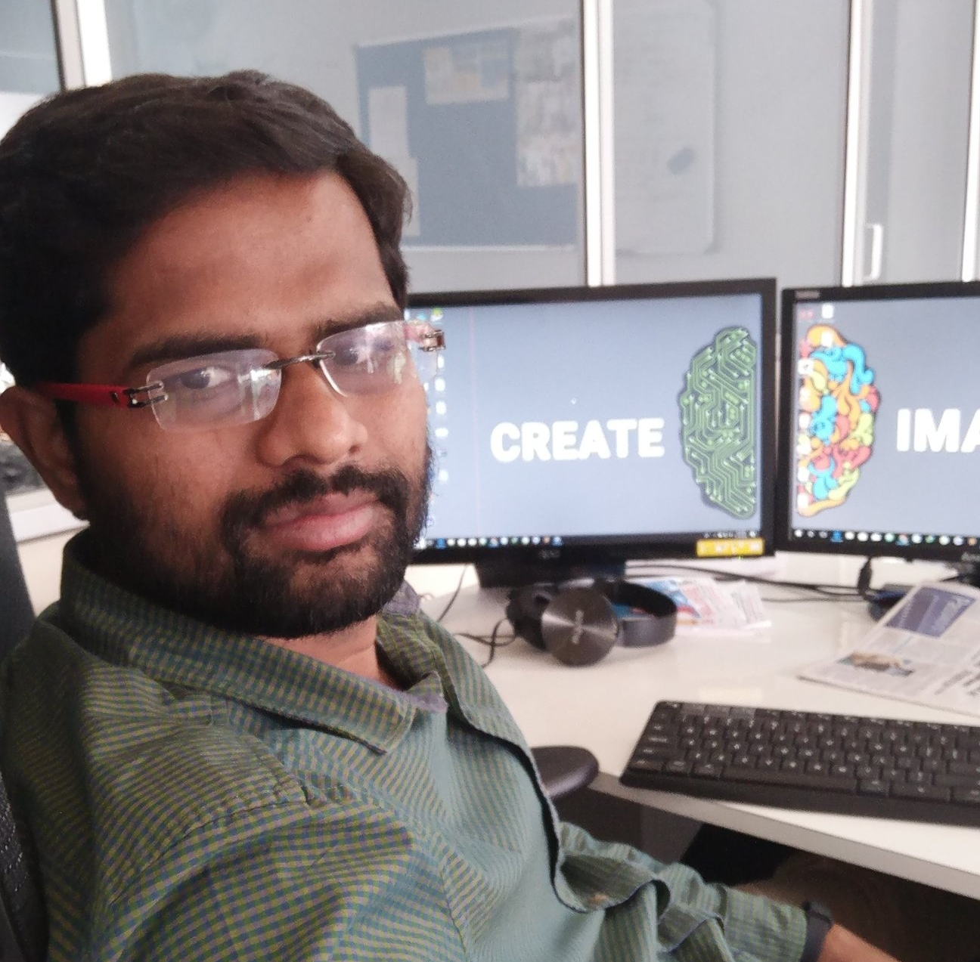
About Me
Learn
Teach
Code
Repeat
Follow me @ github.com/giridhersadineni

Slide 3
Agenda for Today
Lets Learn Python

Slide 4
Python Language
Python is a general-purpose interpreted, interactive, object-oriented, and high-level programming language.
It is Free and developed by Open Source Community Python Software Foundation

Slide 5
History
It was created by Guido van Rossum during 1985- 1990.
It is influenced by Modula 3 & ABC Programming Language

Slide 6
Features
Easy-to-learn -read - maintain
Portable
Supports Popular Databases (MySQL, MSSQL, MongoDB
GUI Programming (Tkinter)
Scalable
Vast Library

Slide 7
Application (Python Usage)
Web and Internet Development
Desktop GUI Applications
Scientific and Numeric
Education
Business Applications
Games and 3D Graphics
Network Programming
Database Access

Slide 8
Which Version ???
Python 2.7
Python 3.X (Latest : 3.7.3)

Slide 9
Lets Start

Slide 10
Installing Python
Goto www.python.org/downloads
Download Version 3.5 if your Operating System is (Windows 7 / XP)
Download Latest Release if your Os in Windows 8 / 8.1 / 10
In Linux / MacOS Version 2.7 is already installed

Slide 11
Getting Started with Python : Setting Path
To add the Python directory to the path for a particular session in Unix −
In the csh shell − type setenv PATH "$PATH:/usr/local/bin/python" and press Enter.
In the bash shell (Linux) − type export PATH="$PATH:/usr/local/bin/python" and press Enter.
In the sh or ksh shell − type PATH="$PATH:/usr/local/bin/python" and press Enter.
Note − /usr/local/bin/python is the path of the Python directory

Slide 12
Choose Your Editor
Visual Studio Code => http://code.visualstudio.com
PyCharm => https://www.jetbrains.com/pycharm/
Python (IDLE Bundled with Python Installler)
Notepad + Console

Slide 13
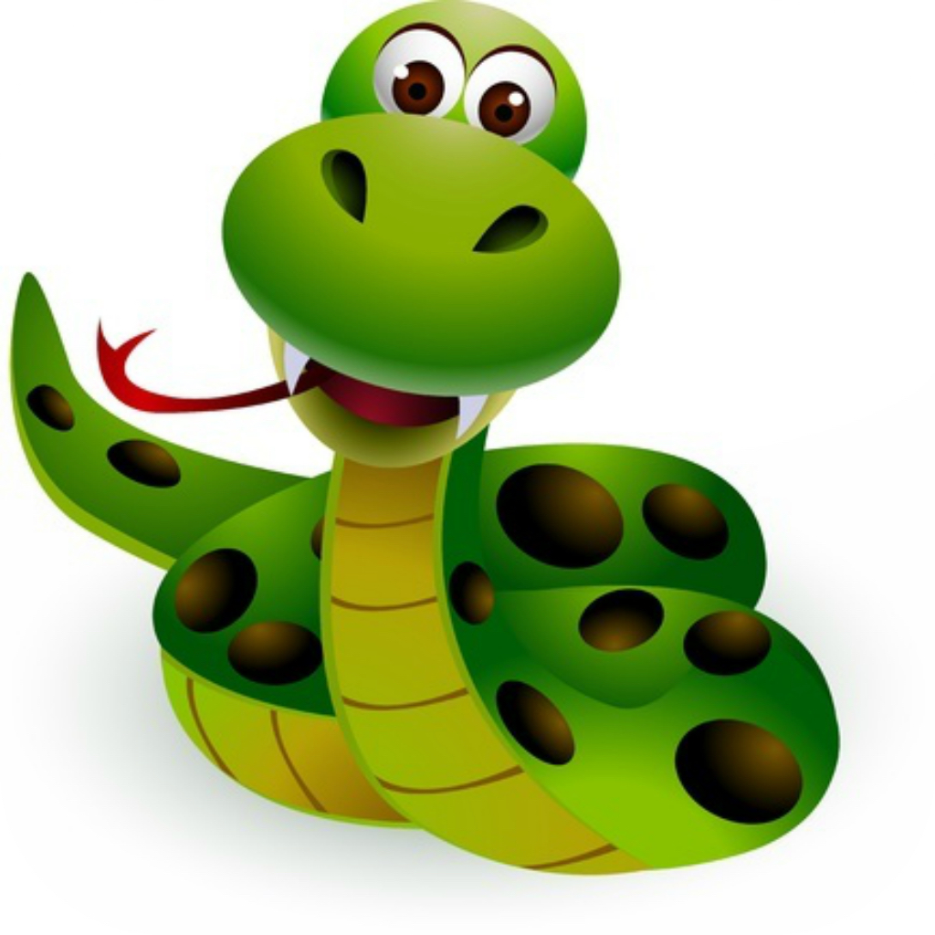
Get Set Go

Slide 14
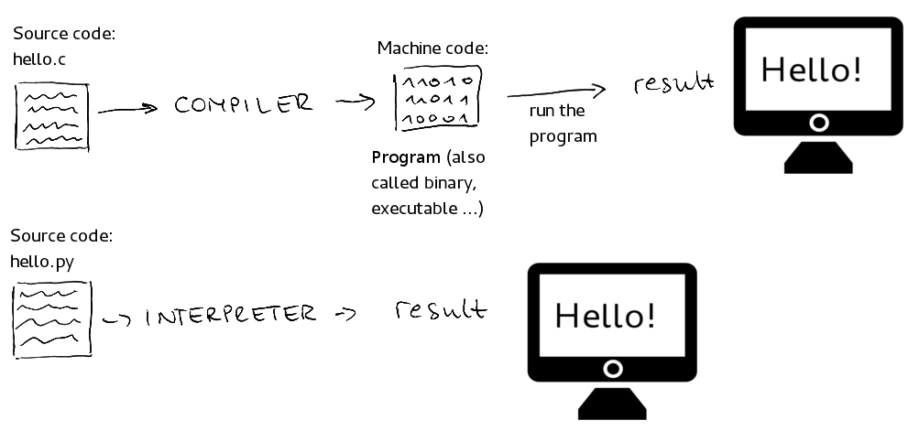
Interpreted vs Compiled

Slide 15
2 Ways to Interact with Python
Interactive Mode | Normal Mode
Take Single User Input, Evaluates them and returns to the User | Executes a Python script on Command Line

Slide 16
Interactive Mode
C:\Users\PC>python
Python 3.7.0 (v3.7.0:1bf9cc5093, Jun 27 2018, 04:59:51) [
Type "help", "copyright", "credits" or "license" for more information.
>>> print “Hello”
Hello
>>>

Slide 17
Normal Mode
C:\Users\PC>python hello.py
Hello
Filename : hello.py
print “Hello”

Slide 18
Language Basics : Variables

Slide 19
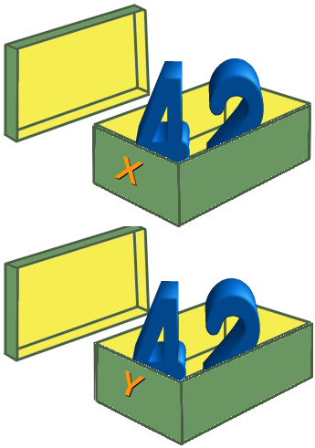
Python Variables
Variable is something which can change.
A variable is a way of referring to a memory location used by a computer program.
This memory location contains values, like numbers, text or more complicated types.
A variable has a name, type, a scope, and above all a value.

Slide 20
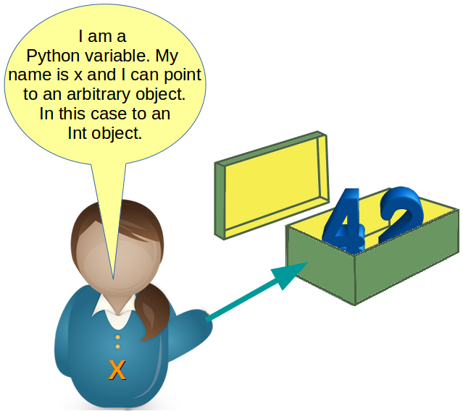

Slide 21
Rules for Naming a Variable
A valid identifier is a non-empty sequence of characters of any length with: The start character can be the underscore "_" or a capital or lower case letter.
The letters following the start character can be anything which is permitted as a start character plus the digits.
Variable names are Case sensitive (Apple != apple)
Python keywords are not allowed as identifier names! See list in next slide

Slide 22
Keywords = Reserved Names
and, as, assert, break, class, continue, def, del, elif, else, except, exec, finally, for, from, global, if, import, in, is, lambda, not, or, pass, print, raise, return, try, while, with, yield

Slide 23
Creating a Variable
>>> x = 42
>>> print(x) 42
>>> x = "Now x references a string"
>>> print(x)
Now x references a string

Slide 24
Data Types
A Data type Specifies the type of data stored inside the Variable
Python's built-in core data types are in some cases also called object types. There are four built-in data types for numbers:
Integer
Long integers
Floating-point numbers,
** Complex numbers are written as <real part> + <imaginary part>j

Slide 25
Complex Number Arithmetic
examples: >>> x = 3 + 4j >>> y = 2 - 3j >>> z = x + y >>> print z (5+1j)

Slide 26
Sequences
Sequences are one of the principal built-in data types.
Python provides for six sequence
Strings
byte sequences
byte arrays
lists
tuples
range objects

Slide 27
Bytes
The bytes object is a sequence of small integers.
The elements of a byte object are in the range 0 through 255,

Slide 28
Strings
Strings are marked by quotes
Wrapped with the single-quote ( ' ) character:
'This is a string with single quotes'
Wrapped with the double-quote ( " ) character:
“Welcome to Python World“

Slide 29
Strings (Cont.)
Wrapped with three characters, using either single-quote or double-quote: '''A String in triple quotes can extend over multiple lines like this one, and can contain 'single' and "double" quotes.'''

Slide 30
>>> s = “Mother Theressa College of Engineering & Technology"
>>> s[0]
M
>>> s[3]
t

Slide 31
Python Doesn’t have Char Datatype
There exists no character type in Python. A character is simply a string of size one.

Slide 32
Operations on String
Concatenation Strings can be glued together (concatenated) with the + operator: "Hello" + "World" will result in "HelloWorld"
>>> name=“Python :”
>>> message =“ is very easy to learn”
>>> name + message
Python : is very easy to learn

Slide 33
Operations on String
Repetition String can be repeated or repeatedly concatenated with the asterisk operator "*": "*-*" * 3
>>> name=“Python ”
>>> name*10
Python Python Python Python Python Python Python Python Python Python

Slide 34
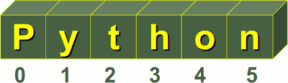
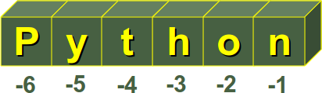
Operations on String
Indexing "Python"[0] will result in "P"
>>> name=“Python ”
>>> name*10
Python Python Python Python Python Python Python Python Python Python

Slide 35
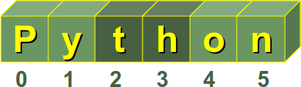
Operations on String
Slicing Substrings can be created with the slice or slicing notation, i.e. two indices in square brackets separated by a colon: "Python"[2:4] will result in "th"
>>> name=“Python ”
>>> name[2:4]
th

Slide 36
Operations on String
Size You find Size of string using a generic function Len
>>> name=“Python ”
>>> len(name)
6

Slide 37
Strings are immutable
>>> name=“giridher”
>>> name[0]='G'
Traceback (most recent call last):
File "<stdin>", line 1, in <module>
TypeError: 'str' object does not support item assignment

Slide 38
Escape Sequences
The backslash (\) character is used to escape characters, i.e. to "escape" the special meaning, which this character would otherwise have.
Examples for such characters are newline, backslash itself, or the quote character.
String literals may optionally be prefixed with a letter 'r' or 'R';
these strings are called raw strings. Raw strings use different rules for interpreting backslash escape sequences.

Slide 39
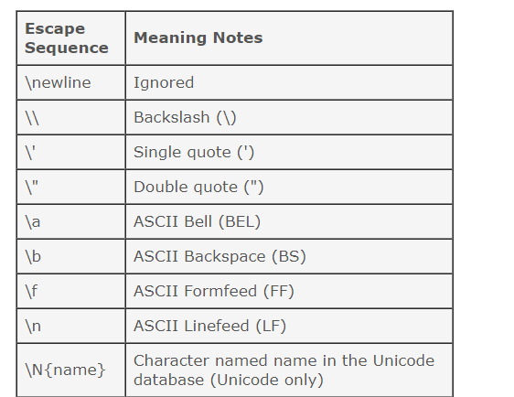

Slide 40
Operators

Slide 41
Arithmetic Operators
Operator | Operation Performed
+ | Addition | 10+20
- | Subtraction | 10-3
* | Multiplication | 10*3
/, % | Division , Modulo | 10/3 10%3
// | Truncation Division | 10//3

Slide 42
Arithmetic Operators
Operator | Operation Performed
+ | Addition | 10+20
- | Subtraction | 10-3
* | Multiplication | 10*3
/, % | Division , Modulo | 10/3 10%3
// | Truncation Division | 10//3

